Slide 1
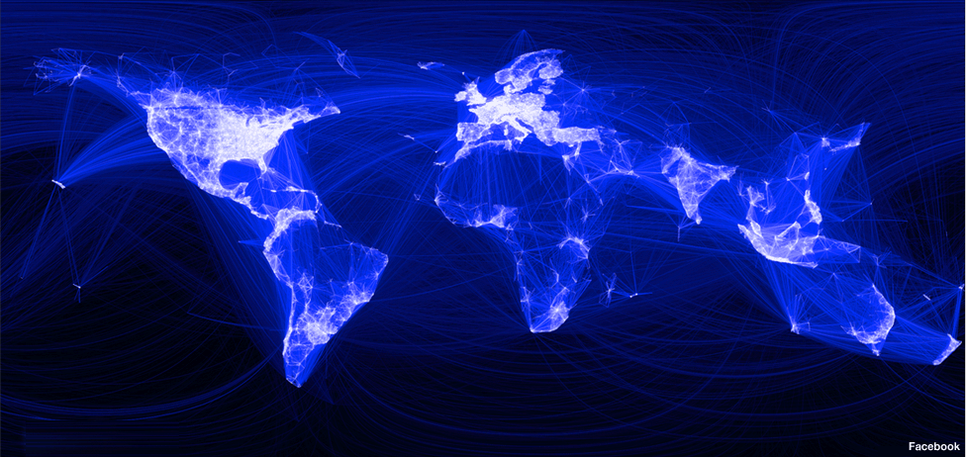


Send Messages
FACEBOOK
Stay connected with friends, family, and coworkers
Create profile
Upload pictures and videos
Explore the World

